Slide 1
The Grid
This section provides you a preliminary background of the grid and the future of the grid.

Slide 2
Current Energy Challenges
Fluctuating demand and supply
Overlapping energy structures
Changing business and operations model
Advent of new end-use technologies, equipment, and controls
Notes:
Consumer behavior including daily, weekly, and seasonal demand profiles, price response, and contract choice.
Overlapping energy markets.
Energy operations, such as distribution automation, load-shedding programs, and emergency operations.
Business operations, such as retail rate, billing, and market-based incentive programs.
End-use appliance technologies, equipment, and controls.

Slide 3
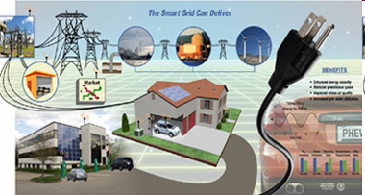
Goal of New Technology
Construction of 21st century electrical system that connects everyone
  Affordable
  Clean
  Efficient
  Reliable
Notes:
http://www.oe.energy.gov/smartgrid.htm

Slide 4
The Grid is Evolving
Electricity Grid
  Multiple interconnected physical networks
  Multiple ownerships structures
  Multiple system operation structures
  Manually controlled communication and coordination
Moves electricity in bulk in one direction
  To consumers and business
Gen 1
Gen 2
Gen 3
…
Gen N
~10⁴
Transmission system
~10⁵
Dist 1
Dist 2
Dist 3
…
Dist N
~10⁷
Cust 1
Cust 2
Cust 3
…
Cust N
~10⁸
Dev 1
Dev 2
Dev 3
…
Dev N
~10⁹
Notes:
Voltages and capacitors are automated but moving power through the system is manually operated.

Slide 5
Smart Grid
Paradigm shift
  Bi-directional
  Load intelligence
  System modernization
Smart grid uses digital technology
  Increase opportunities
  Save energy
  Reduce cost
  Increase reliability and transparency
  Support energy independence
  Address climate change
Gen 1
Gen 2
Gen 3
…
Gen N
~10⁴
Transmission system
~10⁵
Dist 1
Dist 2
Dist 3
…
Dist N
~10⁷
Cust 1
Cust 2
Cust 3
…
Cust N
~10⁸
Dev 1
Dev 2
Dev 3
…
Dev N
~10⁹
Notes:
This paradigm is changing as businesses and homes begin generating more wind and solar electricity, enabling them to sell surplus energy back to their utilities. Modernization is necessary for energy consumption efficiency, real time management of power flows and to provide the bi-directional metering needed to compensate local producers of power. Although transmission networks are already controlled in real time, many in the US and European countries are antiquated by world standards, and unable to handle modern challenges such as those posed by the intermittent nature of alternative electricity generation, or continental scale bulk energy transmission. (wikipedia)
Turn off excess machinery to balance load.
Communication between consumers to utilities
price-demand
if power is too expensive then they can shift load

Slide 6
The Flow of Energy
Nuclear
Electricity
(38 Quads)
Coal
Losses
(25.5 Quads)
Commercial
Renewable
Coal
Residential
Natural Gas
Renewable
$
Natural Gas
Industrial
$
$$$
Use
Petroleum
Petroleum
$
Transportation
$
$
Source: DOE/LLNL (2007) – energy in quadrillion BTU *quads)

Slide 7
Why Simulate the Smart Grid?
Evaluate the potential of new technologies and operational strategies to save capital costs, improve reliability, provide other benefits
Craft and refine the characteristics of technologies and operational strategies for maximum benefit at lowest cost
Understand and quantify synergies of deploying a broad range of smart grid technologies
Avoid unintended consequences that can result from utilizing distributed control systems
Predict and evaluate results from deployment projects
Extrapolate regional/national impacts

Slide 8
Need for a new tool
Ability to study electricity delivery system behavior over long periods of time.
  Understand system behavior
  Evaluate consumer benefits
  Estimate reliability benefits
  Project business outcomes
  Design regulatory policies and utility programs
  Get insight to manage new technology
Notes:
Need to address all the problems stated in the previous slide.

Slide 9
What is GridLAB-D?
Simulation environment
  Build studies and analyze results.
  Uses modeling tools that allow users to create detailed models.
Works with third party data management and analysis tools.
  Works with independent devices.
Tools to create and validate structures
  Examine and verify consumer reaction.
Notes:
Example is needed to elaborate this slide. A demo may be useful.

Slide 10
Unique Capabilities
Detailed time-series simulation
  New devices/strategies/behaviors/interactions
  System growth, capacity expansion, etc.
  Multiple time-scales (seconds to decades)
Simultaneous solution at all levels
Track costs and benefits in scenarios
Extrapolate impacts at higher levels
Open model architecture

Slide 11
Example study*
Prototypical feeder representing what is seen in cold climate regions of the continental U.S.
Primarily residential loads
Details feeder model
  90% overhead lines & 10% underground lines
  1031 primary nodes,
  125 center-tap transformers
  1347 single family homes with triplex lines
Independent regulators for each phase that regulate the voltage at a remote node
* Schneider KP, DP Chassin, Y Chen, and JC Fuller. 2008. "Distribution Power Flow for Smart Grid Technologies." In 2009 IEEE Power System Conference and Exhibition. PNNL-SA-63787, Pacific Northwest National Laboratory, Richland, WA.

Slide 12
Feeder Simulation
Simulation was run for 24 hours with a minimum 1 minute time step (total of 1440 time steps for a single day)
Run with weather data from January 2000 – High was 30°F, Low was 14°F
3 cases were examined
  Regulated at 124V gas heated houses
  Regulated at 120V gas heated houses
  Regulated at 116V gas heated houses

Slide 13
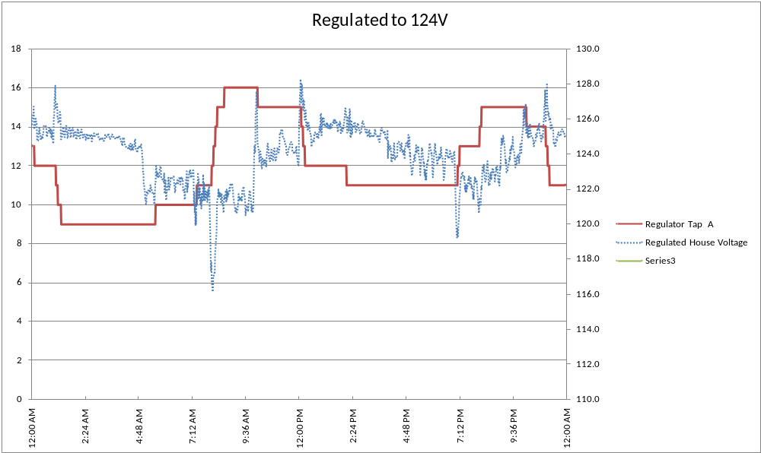
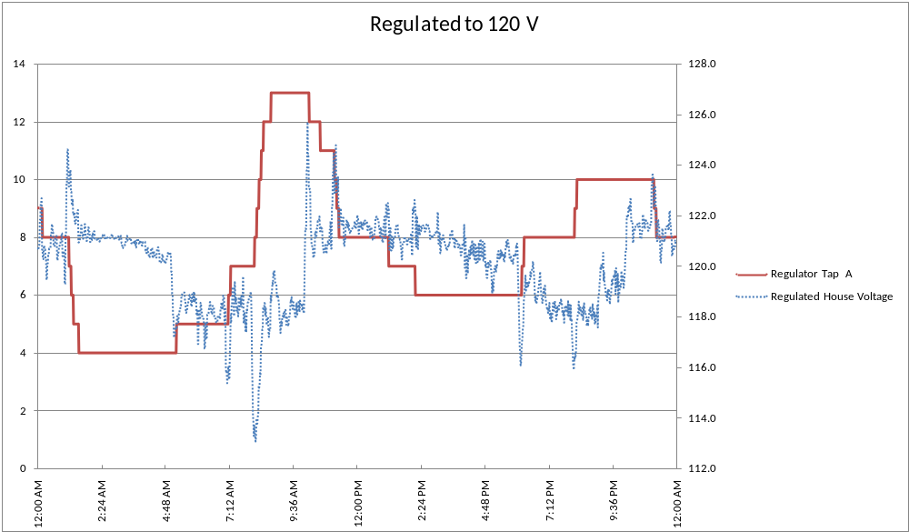
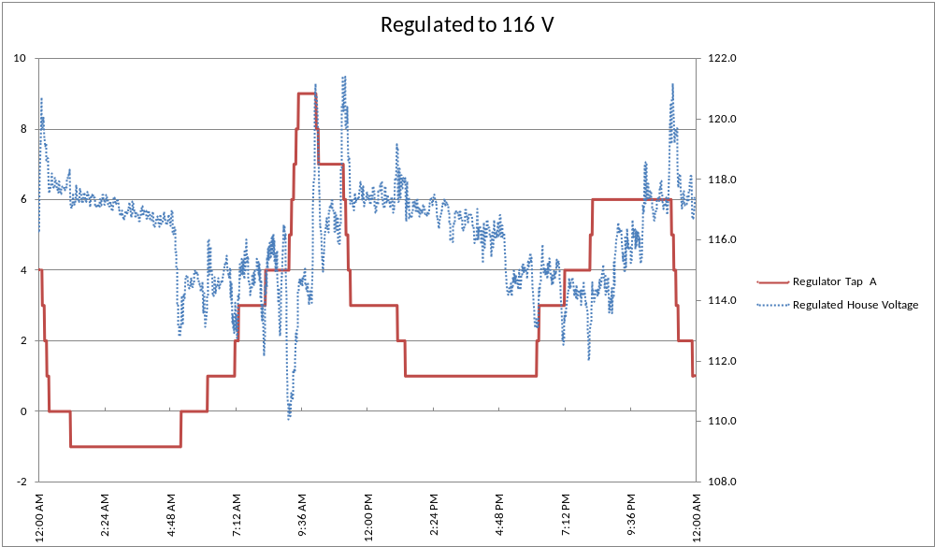
Feeder Simulation

Slide 14
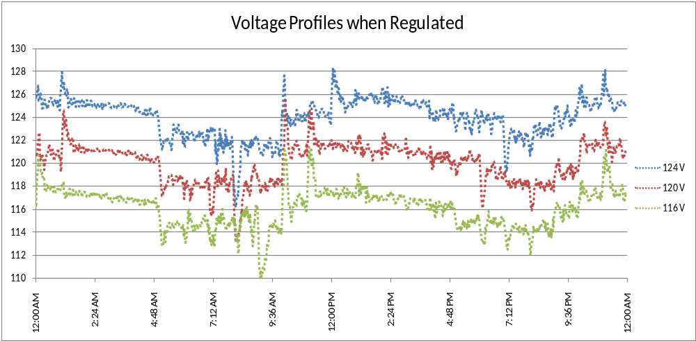
Feeder Simulation

Slide 15
Distribution Losses
 | Measured Energy at Substation (kW-hr) | Measured Energy at Center Tap Transformers (kW-hr) | Measured Energy at Houses (kW-hr) | Losses on System (kW-hr) | Losses on Center Tap Transformers (kW-hr)
124 V | 68,639 | 65,698 | 65,293 | 3,346 | 405
120 V | 67,142 | 64,205 | 63,801 | 3,341 | 404
116 V | 63,949 | 61,104 | 60,714 | 3,236 | 391
6.83 % Reduction
7.01 % Reduction
3.29 % Reduction

Slide 16
CVR Performance Results
CVR Factors
 | 124V - 116V | 124V - 120V
System | 1.06 | 0.68
House | 1.09 | 0.71
Transformer | 1.08 | 0.70
Differences are due to complex load models

Slide 17
Remarks
Complex models allow for a more detailed understanding of system behaviors
New technologies increase complexity and potentially lead to emergent behaviors
Understanding these behaviors will help to determine when the emerging technologies have the most benefit
While the previous example focused on CVR many other technologies will require this level of analysis

Slide 18
Questions and Discussion

